Slide 1
HOW I GENERATED OVER 1,500 LEADS IN 48 HOURS WITHOUT PAID ADS

Slide 2
TOOLS AND RESOURCES
Lead Generating Software
Domain Email
Gmail Account
Email Extractor

Slide 3
HOW TO
To generate free leads
You must give an irresistible offer that
Will prompt your audience to opt in
You must present people an offer that will prompt them to share your campaign

Slide 4
SEE LIVE EXAMPLE

Slide 5
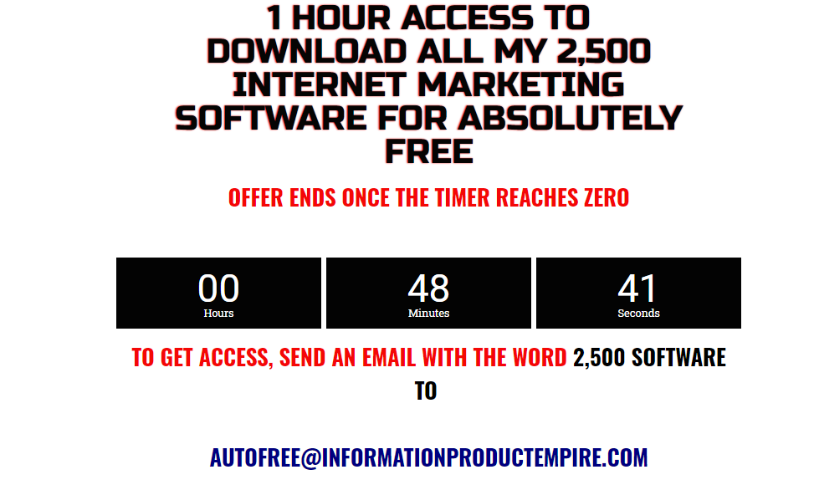

Slide 6
